Slide 1



Multiple Attenuation:
Recent Advances and the Road Ahead (2013)
Arthur B. Weglein
M-OSRP/UH
Monday, September 23, 2013
Recent Advances and the Road Ahead

Slide 2


Slide 3
Multiple removal is a longstanding/outstanding problem in exploration seismology
(1) Recent progress
(2) current outstanding challenges
(3) a proposed road ahead with the potential to address these challenges

Slide 4
Recent progress
In this talk we will:
Recognize and exemplify the progress that has been made and the capability that is currently available and delivered;

Slide 5
The current challenge
In this talk we will:
Recognize that current on-shore and complex off-shore plays increasingly represent challenges with removing multiples that go well beyond our entire collective industry’s capability to effectively respond to/ address;

Slide 6
A proposed response
In this talk we will:
Propose a three pronged technical strategy with the potential to address this current gap between challenge and capability.

Slide 7
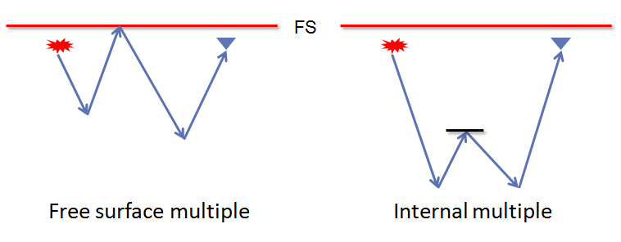
Free surface and internal multiples
Multiples that have experienced at least one downward reflection at the air-water or air-land surface (free surface) are called free surface multiples. Multiples that have all of their downward reflections below the free surface are called internal multiples.
The order of a free-surface multiple is defined as the number of reflections it has experienced at the free surface, independent of the number of downward reflections in its history. In contrast, the order of an internal multiple is defined by the total number of downward reflections it has experienced – independent of the location of the downward reflection.

Slide 8
Status
Distinct algorithms/methods have been developed that:
(1) can eliminate free surface multiples of all orders;
(2) can attenuate internal multiples of all orders.
Attenuate means it reduces the amplitude but does not remove (eliminate) the multiples.
— and these algorithms do not require (1) any subsurface information or (2) selecting a “phantom layer,” where the generators of the internal multiples are assumed to reside, and (3) are independent of earth model type.

Slide 9
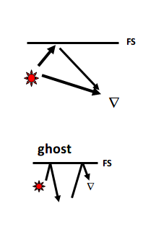
Status
These methods do require (they have prerequisites) :
the direct wave (reference wave) needs to be identified to find the source wavelet and radiation pattern
Source and receiver deghosting

Slide 10
For the free surface and internal multiple algorithms to reach their potential/deliver their promise, these prerequisites need to be satisfied
Energy minimization adaptive subtraction is often called upon to recognize/accommodate all differences between the prediction algorithm and its prerequisites, and all the other factors (beyond the assumed physics) that need to be accommodated to eliminate the multiple.

Slide 11
Major issues in the last 20-25 years:
Industry trend to deep water, and
Exploration plays in ever more complex and ill-defined circumstances.

Slide 12
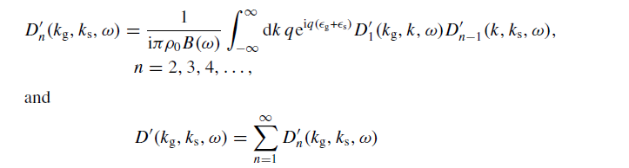
Free surface multiple removal
Carvalho et al. (1992)

Slide 13
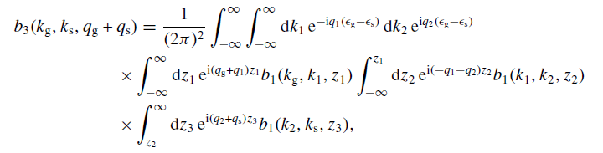
Internal multiple attenuation
Araújo et al. (1994)

Slide 14


Internal Multiple Removal in Offshore Brazil Seismic Data Using the Inverse Scattering Series
Master Thesis
Andre S. Ferreira
Advisor: Dr. Arthur B. Weglein

Slide 15
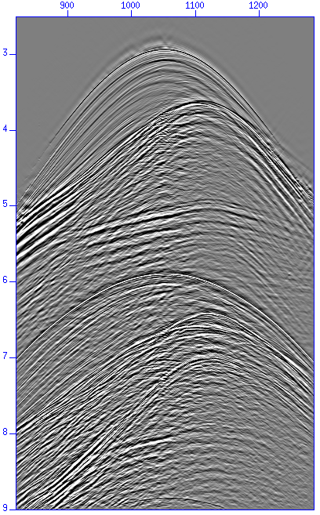
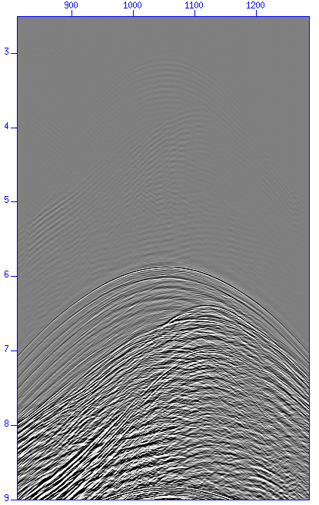
Multiple attenuation
Free surface multiple attenuation
  Multiple prediction
Shot gather
Corresponding multiple
prediction
Notes:
15

Slide 16
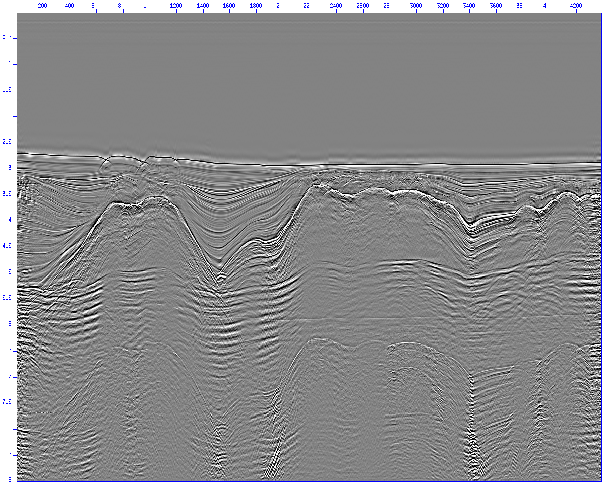
Multiple attenuation
(A. Ferreira, P. Terenghi)
Free surface multiple attenuation
  Stack before free surface multiple removal
Notes:
16

Slide 17
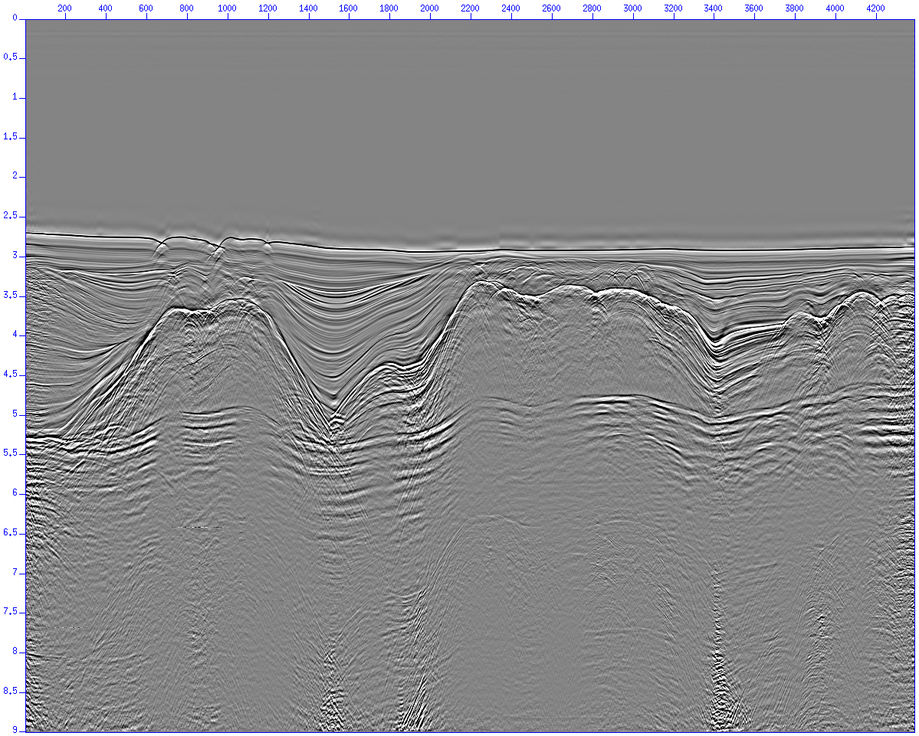
Multiple attenuation
(A. Ferreira, P. Terenghi)
Free surface multiple attenuation
  Stack after free surface multiple removal
Notes:
17

Slide 18
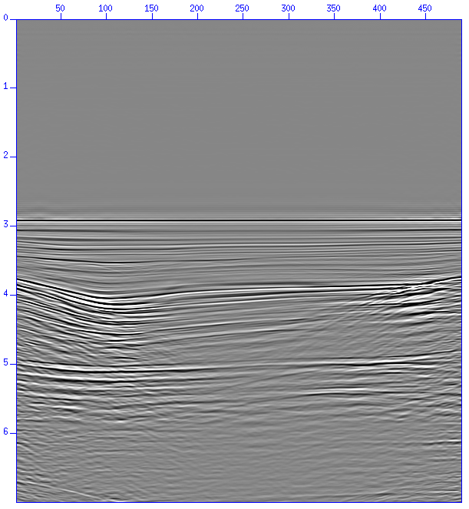
Multiple attenuation
Internal multiple attenuation
  The internal multiple high computer cost process
Notes:
18

Slide 19
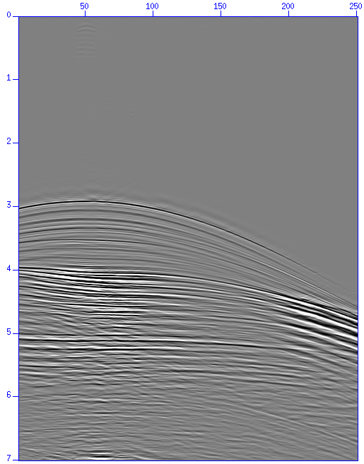
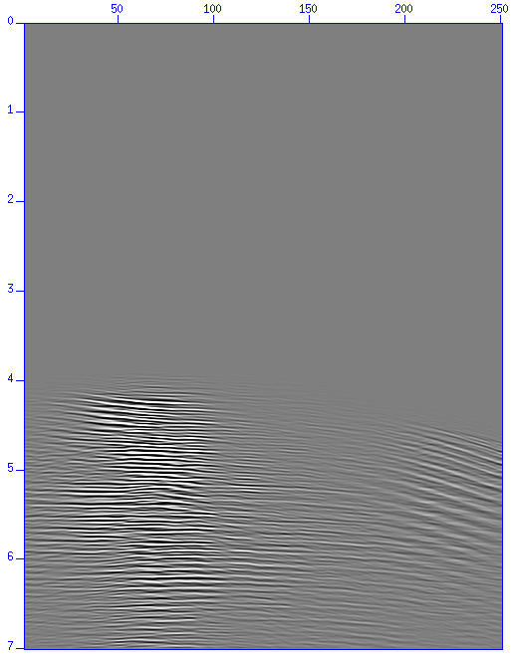
Multiple attenuation
Internal multiple attenuation
  Multiple prediction
Shot gather
Corresponding multiple
prediction
Notes:
19

Slide 20
Multiple attenuation
Internal multiple attenuation results
  Stacked section used to test the internal multiple code

Slide 21
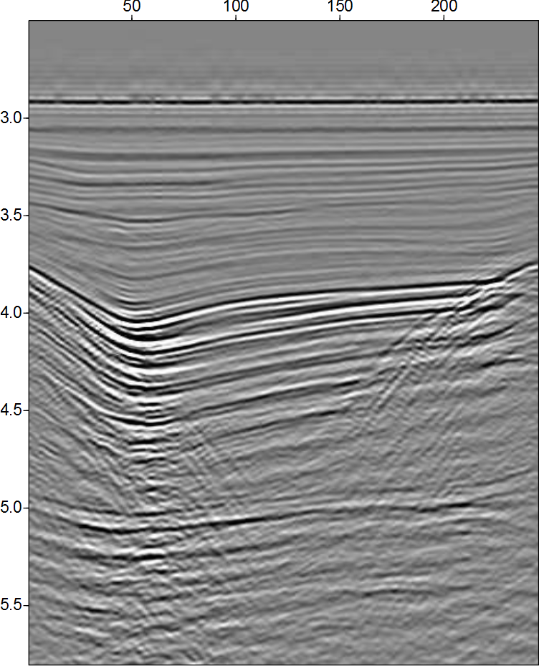
Multiple attenuation
Internal multiple attenuation results
  Common offset sections

Slide 22

Multiple attenuation
Internal multiple attenuation results
  Common offset sections

Slide 23
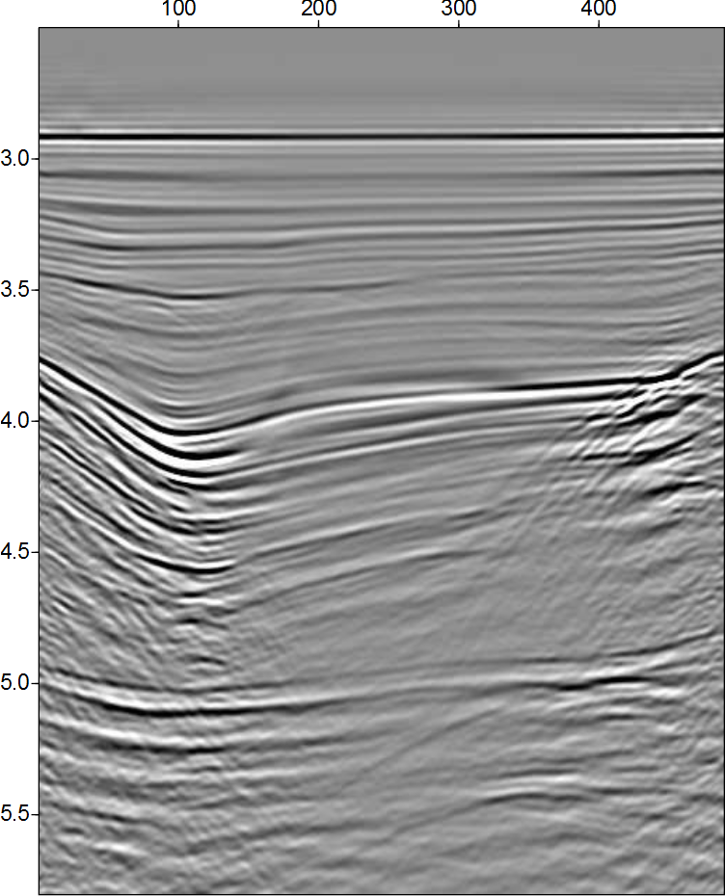
Multiple attenuation
Internal multiple attenuation results
  Stacked sections

Slide 24
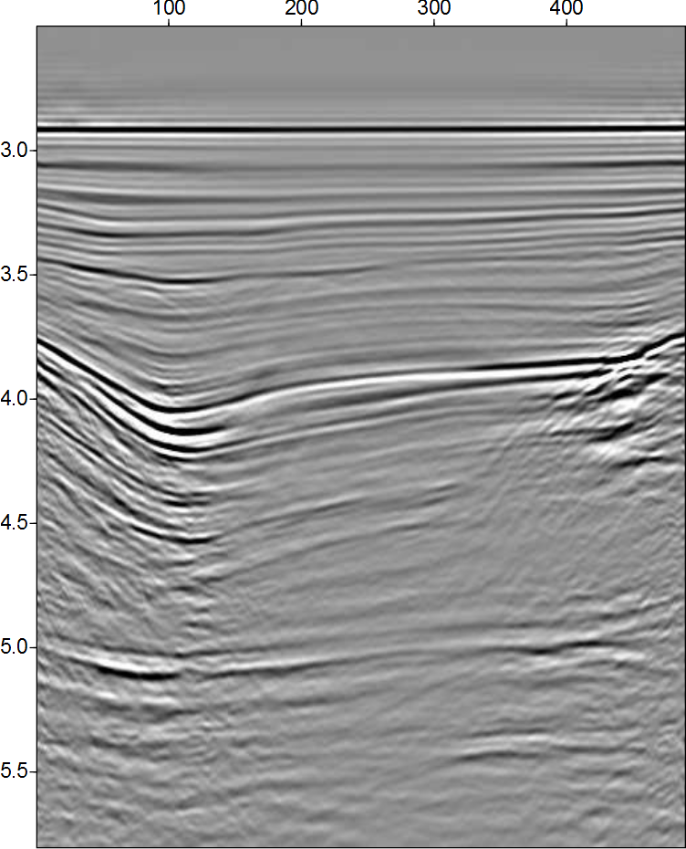
Multiple attenuation
Internal multiple attenuation results
  Stacked sections

Slide 25
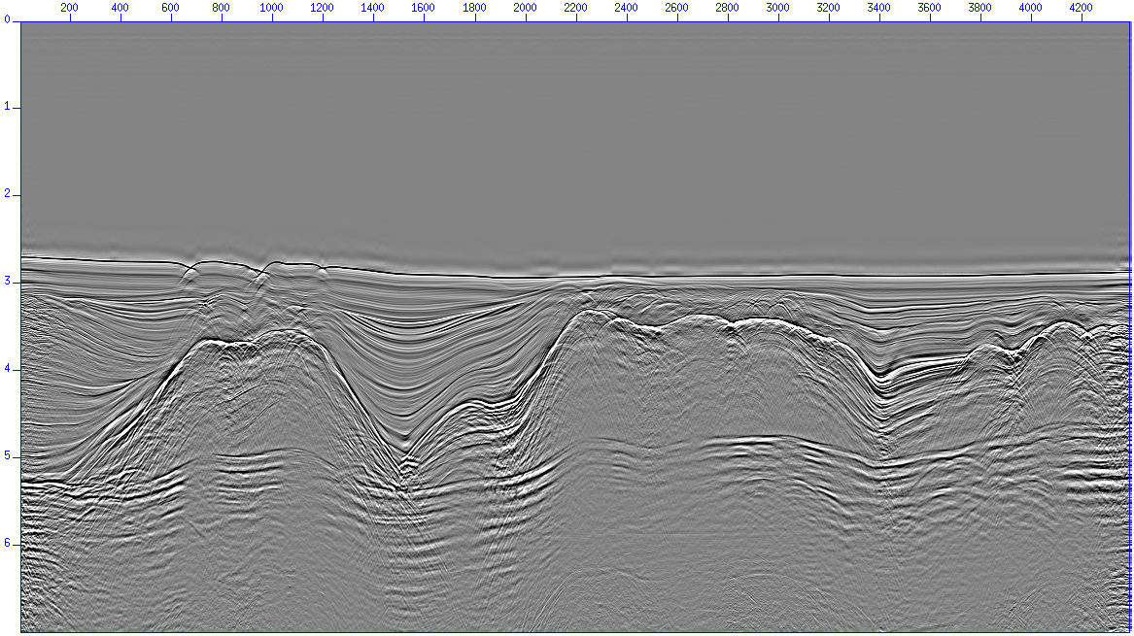
Multiple attenuation
Internal multiple attenuation results (stacked sections)

Slide 26
Multiple attenuation
(A. Ferreira, P. Terenghi)
Internal multiple attenuation results (stacked sections)

Slide 27

Multiple attenuation
(A. Ferreira, P. Terenghi)
Internal multiple attenuation results (stacked sections)

Slide 28
Conclusions
(A. Ferreira et al.)
Multiple removal/attenuation is a major problem in seismic exploration
Free surface multiple removal results
  Multiple prediction is excellent
    Improved when source wavelet information was provided
  Anti-alias filter application is important
  Multiples from 3D structures are attenuated but not removed
  Adaptive subtraction required
Internal multiple attenuation results
  Multiple prediction is excellent
  Very high computer cost (both CPU time and memory)
  Adaptive subtraction required

Slide 29
Conclusions
(A. Ferreira et al.)
ISS methods were able to attenuate both free surface and internal multiples in a very complex situation
  No a priori information about the dataset is necessary
  No other tested method was able to attenuate the sequence of internal multiples below the salt layers
  High computer cost (internal multiples)
  Adaptive subtraction requirement

Slide 30
Land application of ISS internal multiple
“Their (ISS internal multiple algorithm) performance was demonstrated with complex synthetic and challenging land field datasets with encouraging results, where other internal multiple suppression methods were unable to demonstrate similar effectiveness.”
- Yi Luo, Panos G. Kelamis, Qiang Fu, Shoudong Huo, and Ghada Sindi, Saudi Aramco; Shih-Ying Hsu and Arthur B. Weglein, U. of Houston, “The inverse scattering series approach toward the elimination of land internal multiples.” Aug 2011, TLE

Slide 31
Current challenges
The industry trend to more complex and difficult on-shore and offshore plays

Slide 32
These plays can often have proximal or interfering primary and multiple events, and multiples of different orders interfering
That raises the bar on multiple removal effectiveness: to predict the amplitude and phase of all orders of free surface and internal multiples

Slide 33
That trend has returned multiple elimination to center stage within M-OSRP
In principle, the ISS has subseries that can eliminate (amplitude and phase predict) all free surface and internal multiples—locate that capability, directly and without subsurface information. The ISS is the only method with that promise and potential.

Slide 34
All ISS subseries share a common set of
  prerequisites
  Reference wave removal
  Deghosting
  Source signature and radiation pattern identified
    and utilized (accommodated) in the algorithms
Green’s theorem provides methods to achieve these prerequisites that are consistent with the ISS methods they are meant to serve – in fact those prerequisites are steps taken in all derivations of ISS task specific subseries.

Slide 35
Develop a new adaptive criteria (and algorithms that seek to satisfy that criteria) that derive from and align with ISS algorithms

Slide 36
Three pronged strategy
  Improve satisfaction of prerequisites (in particular develop methods for on-shore)
  Stronger algorithms (eliminate internal multiples of all orders)
  Consistent adaptive criteria and subsequent prediction methods
For off-shore and on-shore applications

Slide 37
A three pronged multiple attenuation strategy
Provide methods from the Inverse Scattering Series (ISS) that predict the phase and amplitude of all orders of free surface and internal multiples at all offsets
Provide the prerequisites, e.g., the removal of the reference wavefield, the wavelet, and deghosted data required by ISS methods
Develop a replacement to the energy minimization criteria behind adaptive subtraction methods with a property that always is satisfied by (aligns with) the free surface and internal multiple algorithms

Slide 38
Identify the limitations in the lowest order ISS internal multiple attenuator
Attenuate
Spurious events
Extend that algorithm to remove those limitations.

Slide 39
Pre-requisite
With and without ghost
FS
7m
Source
9m
WB
300m
One reflecting horizons; source depth, 7m; receiver depth, 9m; receiver interval, 3m; 1601 traces.
Notes:
A series of air guns align in the horizontal line in one depth. Source interval and receiver interval is 3 meter.

Slide 40
Free Surface Multiple Elimination Results Without Ghosts Removed
Input data with ghosts
Free-surface multiple prediction
Data after free-surface multiple removal
(Jinlong Yang, Jim Mayhan 2013)

Slide 41
Free Surface Multiple Elimination Results With Ghosts Removed
Input data without ghosts
Free-surface multiple prediction
Data after free-surface multiple removal
(Jinlong Yang, Jim Mayhan 2013)

Slide 42
Synthetic model, constant velocity, invisible primary
Downward reflection point (DRP)
Reflection
Coefficient
Depth (m)
375
.50
535
.45
910
.80
Dragoset 2000
42
Notes:
This is a very special earth model used to generate the synthetic shot record shown in the next slide. The horizon depths and reflection coefficients were selected so that the surface multiple whose raypath is shown exactly coincides with the primary reflection from the deepest horizon. Furthermore the two events have exactly the same amplitudes. (Note that this model is totally artificial. It has constant velocity and there is no absorption. Nevertheless, it helps illustrate the power of SRME in a remarkable way.)

Slide 43
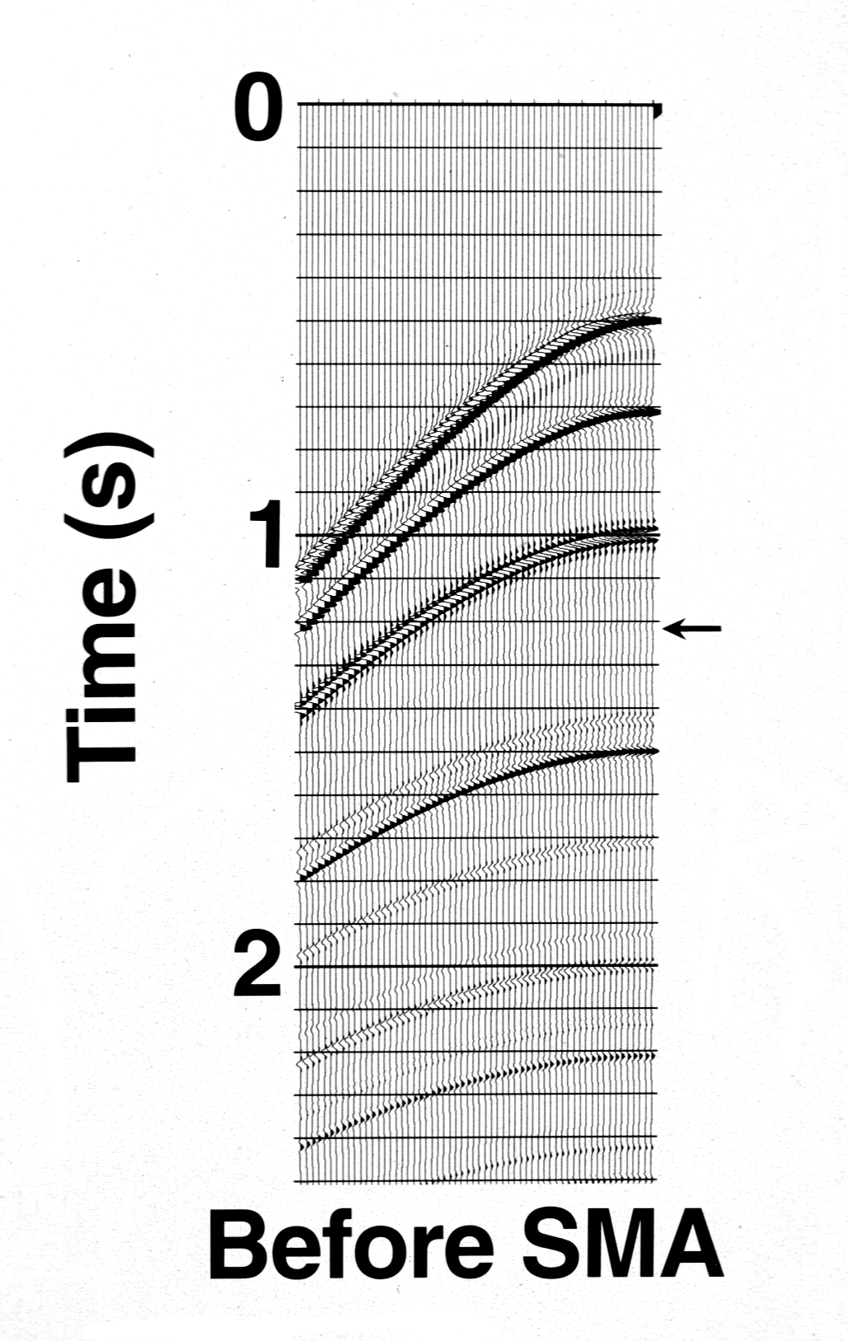
Synthetic shot
43
Notes:
A primary reflection at the arrow is missing because it has been perfectly cancelled out by an interfering surface multiple.

Slide 44
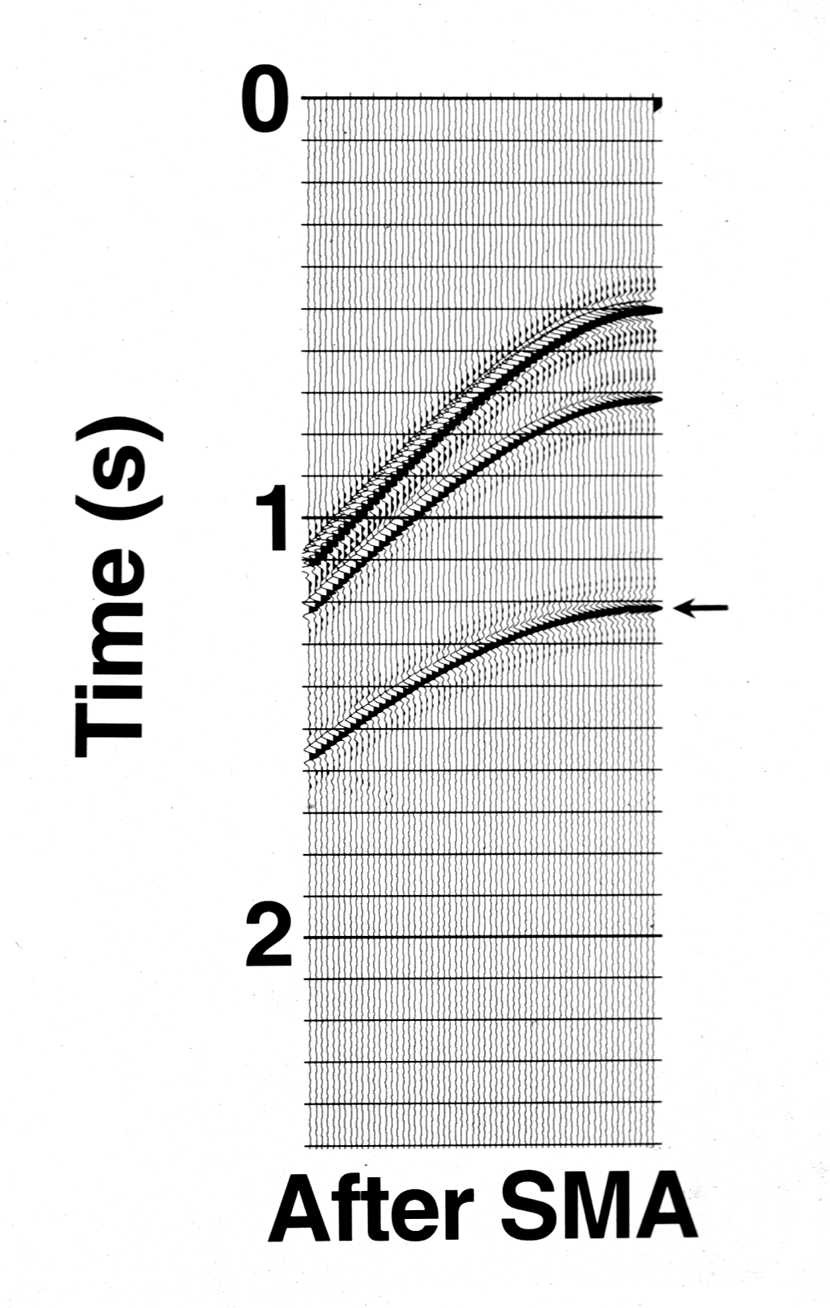
Synthetic shot after ghost and FS multiple removal
44
Notes:
The WesternGeco SMA version of SRME produced this result. Note that all of the surface multiples are gone and that the missing primary has been recovered. Clearly, no algorithm based on moveout discrimination or periodicity could have produced this result. (Technical detail – A sharp eye might have noticed that the two primary events in this shot have a different wavelet than the corresponding events on the previous slide. This is because SMA is a frequency domain algorithm and the frequency range specified by the user did not match exactly the actual frequency range of the input data. The difference in the wavelet is due to the resulting frequency domain filtering.)

Slide 45
Model
V=1500m/s ρ=1.0g/cm³
500m
V=1700m/s ρ=1.8g/cm³
1700m
V=1700m/s ρ=1.0g/cm³
2700m
V=3500m/s ρ=4.0g/cm³
5700m
V=5000m/s ρ=4.0g/cm³
Yanglei Zou 2013

Slide 46
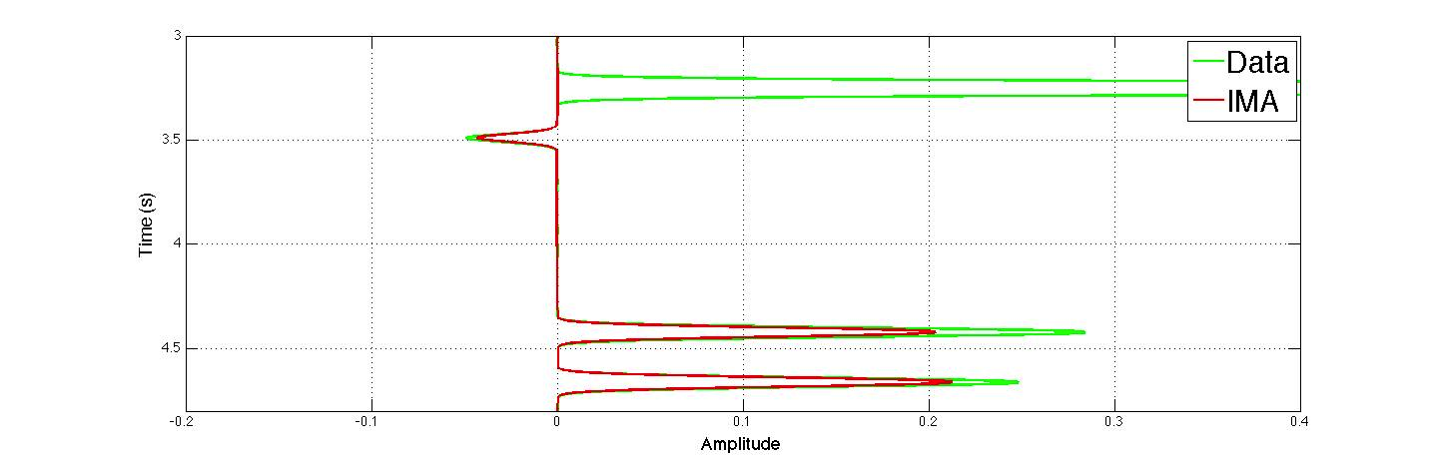
Attenuation algorithm for internal multiples from ISS
P₃
IM₂₁₂
IM₃₂₃
IM₂₁₃ and IM₃₁₂
1
2
Yanglei Zou 2013
3
P₃
IM₂₁₂
IM₂₁₃
IM₃₁₂
IM₃₂₃

Slide 47
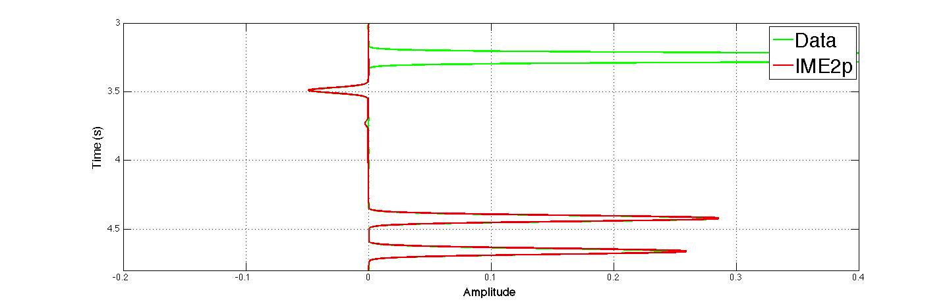
Elimination algorithm for internal multiples from ISS
P₃
IM₂₁₂
IM₃₂₃
IM₂₁₃ and IM₃₁₂
1
2
Yanglei Zou 2013
3
P₃
IM₂₁₂
IM₂₁₃
IM₃₁₂
IM₃₂₃

Slide 48
Q compensation without Q
With K. Innanen (U. Calgary) and J. E. Lira (Petrobras)

Slide 49
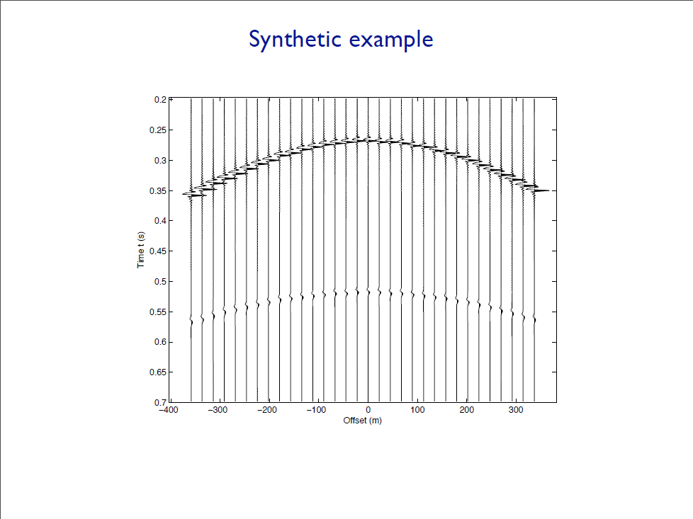

Slide 50
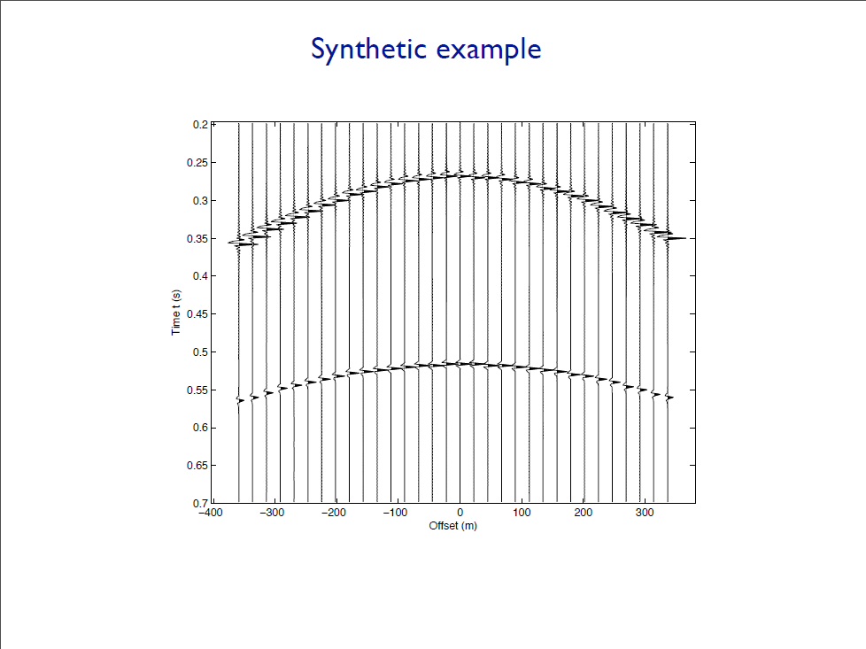

Slide 51
Recent Advances and the Road Ahead (2013)
Summary
As with seismic imaging and inversion – today there is much to celebrate; much fundamental work yet to be done.
We have demonstrated recent progress and propose a three pronged strategy for the road ahead.
For on-shore internal multiple elimination that strategy will require new ideas, concepts, and capability.

